Slide 1
10.6 Parametric Equations

Slide 2
Definitions/Characteristics
Introduce a 3rd variable- called the parameter
A common parameter used is time (t) or an angle (trig)
(x, y) is the place, “t” is the time it is there (at that place)

Slide 3
Graphing Parametric Equations
2 OPTIONS:
(1) Use a chart to find rectangular points.
Plot the points.
Show the orientation (flow) by arrows
(2) Convert to a rectangular equation and graph it

Slide 4
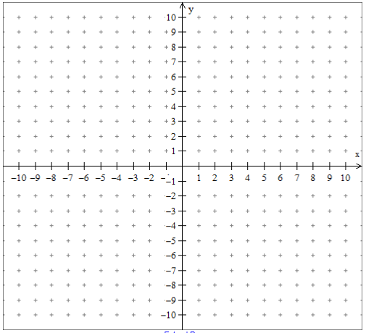
Graphing Using a Chart

Slide 5
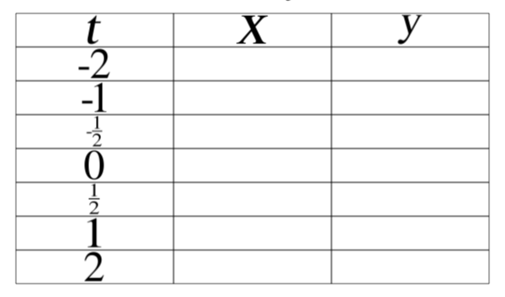
Graphing Using a Chart

Slide 6
Converting from Parametric to Rectangular (Eliminating the Parameter)
Steps:
Solve for the parameter
Substitute the parameter into the 2nd equation
Simplify

Slide 7
Examples: Parameter is time
1.) x = t + 4, y = t – 7 2.) x = t² – 4, y = t/2

Slide 8
Examples: Parameter is time
3.) $x= \sqrt{t}+5$, y = 2t – 7 4.) $x= \left|t−2\right|$, y = t + 4

Slide 9
Examples: Eliminating the Angle Parameter
1.) $x=3cosθ, y=4sinθ$ 2.) $x=2cosθ, y=2sinθ$

Slide 10
Converting from Rectangular to Parametric
Must be given the parameter
Steps:
Plug the given parameter into the rectangular equation
Simplify

Slide 11
Examples
Given: y = 1 – x²
Find the parametric equations given the following parameters:
1.) t = x 2.) t = x + 3 3.) t = 1 – x

Slide 12
Practice Problems
Pg 776-777 # 3-14, 17, 18, 37-44

